Slide 1

Fraud Detection in Online Consumer Reviews
Enhancing Trust and Integrity in E-commerce
Kena Patel, Curtin University (Institute of Data)
Connect with Me:
LinkedIn: linkedin.com/in/kena-patel-85341b23
GitHub: Fraud Detection in Online Consumer Reviews.
Notes:
Good morning, everyone. Thank you for joining me today. My name is Kena, and I’m excited to present our project on Fraud Detection in Online Consumer Reviews.
In today’s our digital marketplace, many customers rely heavily on reviews to guide their purchasing choices.
This makes it crucial that these reviews are authentic and trustworthy.
Unfortunately, we’re witnessing a concerning rise in fake reviews. These not only mislead consumers but also pose serious challenges for businesses, leading to misinformed decisions and a gradual erosion of trust.
This is where our project comes in. Our goal is to tackle this issue head-on by utilizing advanced machine learning techniques to detect and combat fraudulent reviews.
By doing so, we aim to create a more reliable and transparent online shopping experience for both consumers and businesses alike.”

Slide 2
Introduction
The Role of Online Reviews in Consumer Decision-Making
Crucial for influencing purchasing choices.
Many consumers rely on the experiences of others
Importance of Authenticity in Reviews.
Builds trust between consumers and businesses.
Increases confidence in purchasing decisions.
Growing Issue of Review Fraud Affecting Businesses and Consumers.
Threatens consumer trust and distorts product value.
Can lead to poor purchasing decisions and damage to business reputations.
Employing machine learning techniques to detect and identify fraudulent reviews.
Aiming to empower consumers and help businesses maintain credibility.
Project Focus
Notes:
“I’d like to discuss the significant role online reviews play in shaping consumer decisions.
In today’s digital marketplace, many customers rely heavily on reviews to guide their purchasing choices,
making it crucial that these reviews are authentic and trustworthy.
However, we are witnessing a concerning rise in fake reviews, which not only mislead consumers but also pose serious challenges for businesses.
This situation leads to misinformed decisions and a gradual erosion of trust in the marketplace.
This is where our project comes in. Our goal is to tackle this issue head-on by utilizing advanced machine-learning techniques to detect and combat fraudulent reviews. By doing so, we aim to create a more reliable and transparent online shopping experience for both consumers and businesses alike.”

Slide 3
Agenda
Problem Statements
Outcomes and Implementation
Stakeholders
Modelling
Business and Data Questions
Data Science Process
Notes:
Let’s take a look at our agenda for today's presentation:
Overview of the problem of fraudulent reviews.
Key stakeholders and their concerns.
Business and data questions guiding our project.
Data science process and findings from our exploratory analysis.
Modeling phase and results.
Implementation strategies.
Key takeaways and next steps."

Slide 4
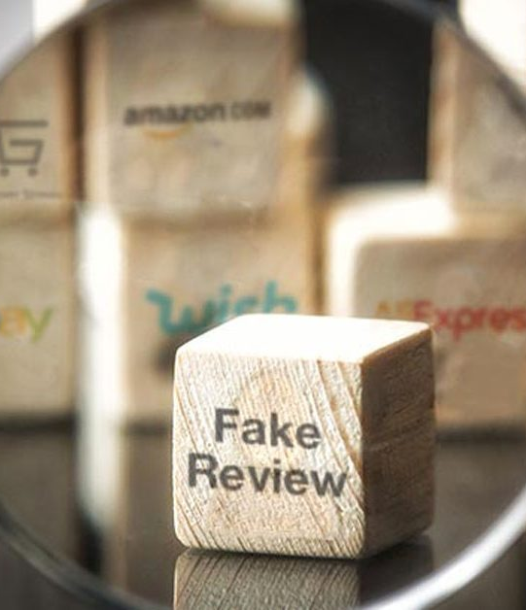
Problem Statements
Loss of Consumer Trust
Revenue Impact
Increased Customer Complaints and Returns
Regulatory Compliance Risks
Review fraud undermines consumer trust and business reputation.
Difficulty in recognizing between genuine and fake reviews.
Lack of effective tools for businesses to monitor and manage reviews.
Notes:
Fraudulent reviews pose several challenges, including loss of consumer trust, revenue impact, increased complaints, regulatory risks, difficulty in identifying genuine reviews, and lack of effective monitoring tools.
=============================================================================
“Let’s start by discussing the key challenges posed by review fraud:”
“1. Loss of Consumer Trust: Fraudulent reviews can significantly erode customer trust in your brand.”
“2. Revenue Impact: Fake reviews lead to lost sales and decreased profits.”
“3. Increased Customer Complaints and Returns: Misleading reviews often result in higher customer complaints and product returns.”
“4. Regulatory Compliance Risks: Ignoring the issue of review fraud may expose your business to potential legal risks.”
“5. Difficulty in Identifying Genuine vs. Fake Reviews: Consumers struggle to distinguish between authentic and fake reviews.”
“6. Lack of Effective Monitoring Tools: Many businesses lack the necessary tools to manage and monitor reviews effectively.”
==========================================================

Slide 5
Stakeholders
Consumers rely on authentic reviews for informed purchasing decisions.
E-commerce platforms seek to maintain credibility and trustworthiness among users.
Businesses and brands aim to protect their reputation and prevent losses from fraudulent reviews.
Review platforms require effective systems to monitor and manage review authenticity.
Regulatory authorities focus on ensuring fair practices and consumer protection in online markets.
Data scientists and analysts engage in developing and implementing the fraud detection model.
Notes:
“Now, let’s look at the key stakeholders affected by these challenges:”
“Consumers: Rely on authentic reviews to make informed purchasing decisions.”
“E-commerce Platforms: Strive to maintain credibility and trustworthiness among their users.”
“Businesses and Brands: Aim to protect their reputation and prevent losses caused by fraudulent reviews.”
“Review Platforms: Need effective systems to monitor and ensure review authenticity.”
“Regulatory Authorities: Focus on enforcing fair practices and consumer protection in online markets.”
“Data Scientists and Analysts: Work on developing and implementing fraud detection models.”

Slide 6
Business & Data Questions
What characteristics differentiate genuine reviews from fraudulent ones?
How can machine learning models effectively classify reviews?
What data sources are available for training these models?
How can results be integrated into existing review systems?
Notes:
“After key stakeholders and their concerns, let's focus on the business and data questions that will shape our project.
First, we need to define our business objectives and determine what metrics or KPIs (Key Performance Indicators )will measure our success.
Next, we'll explore the characteristics that distinguish genuine reviews from fraudulent ones and identify the available data sources, ensuring we maintain data quality.
We will also investigate how machine learning models can effectively classify reviews and how we can integrate our findings into existing systems.
Finally, we must consider potential challenges in data collection and analysis, along with strategies to mitigate those risks.
========================================================================================================================
By answering these questions, we align our project with stakeholder needs and build a strong foundation for our fraud detection solution.”

Slide 7
Data Science Process
Data Collection: Gathering labeled review data from platforms like Amazon.
Data Preprocessing: Cleaning and preparing data for analysis.
Feature Engineering: Identifying key features that indicate review authenticity.
Model Selection: Choosing appropriate algorithms (e.g., MNB, SVM, LR, XGB).
Notes:
“Having identified the key business and data questions, we will now focus on the data science process that will guide our project.
This process includes collecting labeled review data, preprocessing for quality, feature engineering, and selecting suitable algorithms such as Random Forest, Support Vector Machine, and XGBoost to combat review fraud

Slide 8
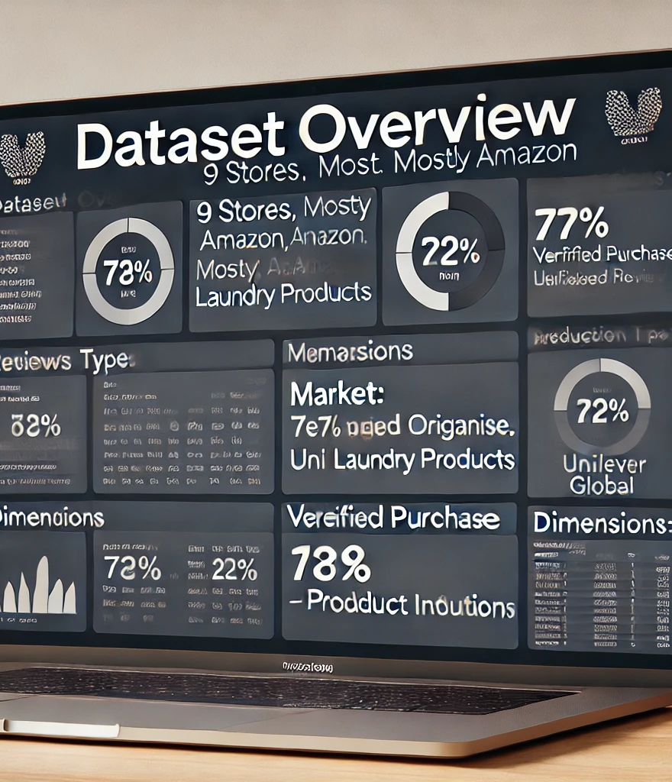
Dataset
Source: 9 stores, primarily Amazon
Category: Personal Care (Laundry products, Comfort brand)
Manufacturer: Unilever Global
Review Types: 77% Organic, 22% Syndicated
Verified Purchase: True/False flag
Market: UK reviews
Dimensions: 1-8 related to additional product details, mostly Laundry.
Notes:
The dataset includes reviews from 9 UK stores, mainly Amazon, focusing on laundry products from Unilever. 77% of the reviews are organic, with common positive feedback like 'good' and 'great value.' Most data is from the Personal Care category, and the dataset covers various product details across eight dimensions. It provides a solid base for analyzing customer sentiment
Now, let's move on to the Exploratory Data Analysis (EDA) phase. This helps us understand the underlying patterns, trends, and insights from the dataset

Slide 9

Exploratory Data Analysis
Notes:
Now, let's move on to the Exploratory Data Analysis (EDA) phase. This helps us understand the underlying patterns, trends, and insights from the dataset

Slide 10
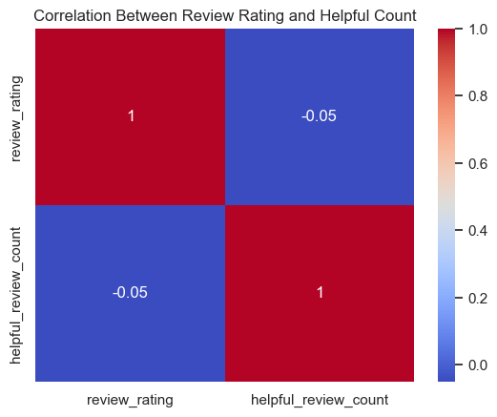
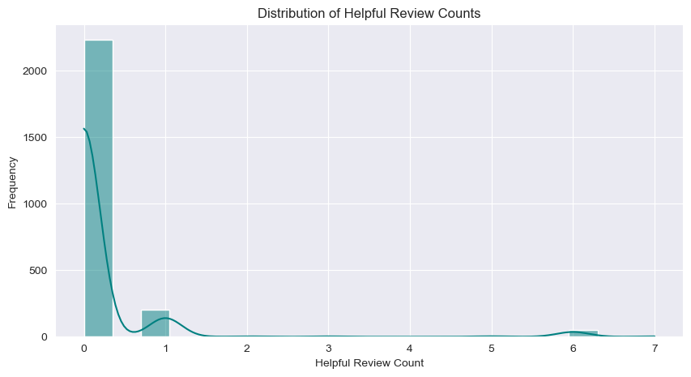
Distribution of Helpful Review Counts
Distribution of Helpful Review Counts:
Most reviews have 0 helpful votes.
Very few reviews have more than 1 helpful vote.
Helpfulness voting is not widely used by customers.
Correlation Between Review Rating and Helpful Count:
Low correlation (-0.05) between review ratings and helpful votes.
High review ratings don’t necessarily mean the review is helpful.
Notes:
Now, let's move on to the Exploratory Data Analysis (EDA) phase. This helps us understand the underlying patterns, trends, and insights from the dataset
"From these charts, we can see that most reviews don’t receive helpful votes. Even when they do, there's almost no relationship between the review rating and how helpful it's considered by other customers. This tells us that helpfulness votes are not playing a major role in influencing purchase decisions based on review quality.“
>We're excluding the helpful_review_count feature because it mostly contains zeros, which won't provide meaningful insights. This decision will help enhance the model's accuracy in identifying genuine reviews

Slide 11
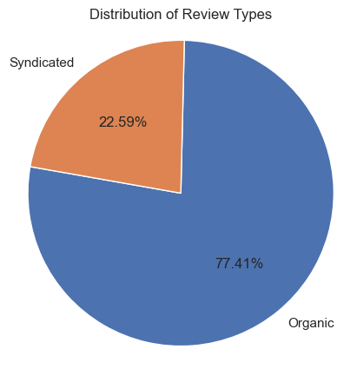
Distribution of Review Types
Organic Reviews:
77.41% of the reviews are organic
Majority of reviews are from direct customers.
Syndicated Review:
22.59% are syndicated, meaning they are sourced from other platforms.
A significant portion of reviews comes from external sources, indicating syndication is a notable factor in reviews.
Notes:
. This pie chart shows that about 77% of the reviews are organic, while 23% are syndicated from other platforms. This indicates that most feedback comes directly from users on this platform, but syndicated reviews still play a considerable role

Slide 12
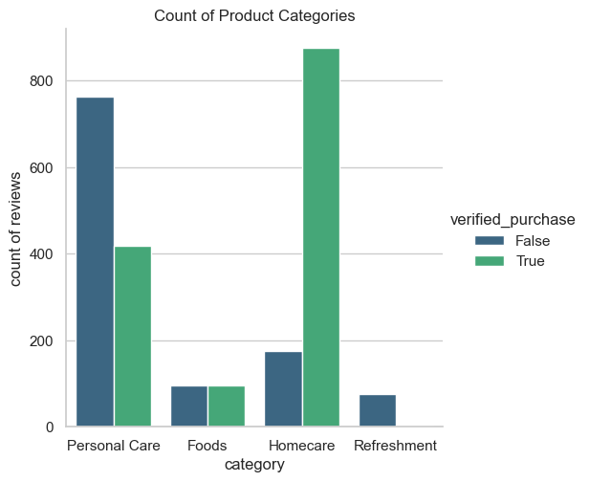
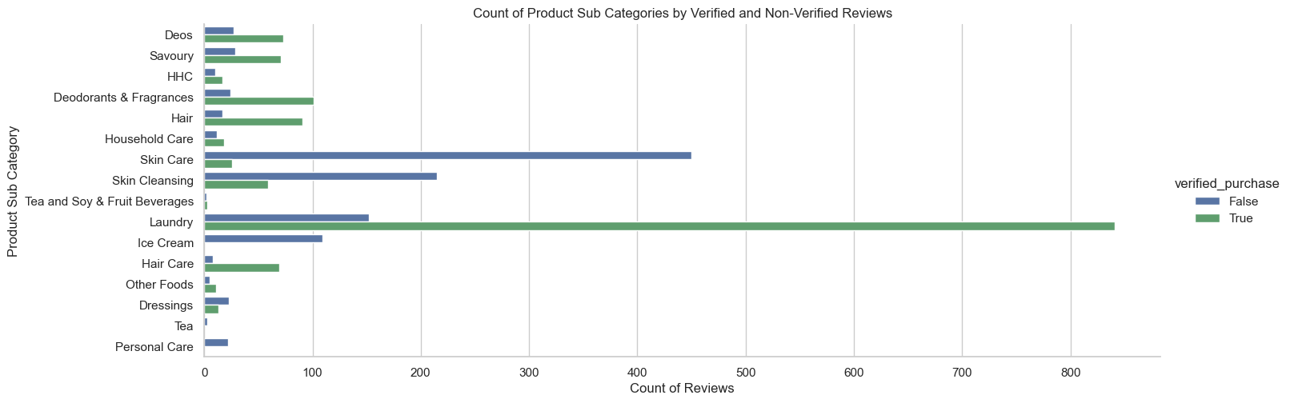
Analysis of Product Categories and Subcategories with Verified Purchases (VP) data
Top Categories:
Homecare and Personal Care have the highest number of reviews.
Verified purchases dominate Homecare reviews.
Subcategory Insights:
Laundry is the most reviewed subcategory, largely from verified purchases.
Skin Care has a higher proportion of non-verified reviews.
Verified vs Non-Verified Trends:
Overall, verified purchases are more frequent, signaling greater reliability.
Notes:
“Here we are looking at the breakdown of product reviews by category and subcategory, highlighting whether they come from verified or non-verified purchases.“
“On the top, you can see Homecare and Personal Care categories have the most reviews, with a significant proportion from verified purchases. This suggests more reliable feedback.“
“Looking at subcategories, Laundry dominates with verified purchases, while Skin Care has a mix but more non-verified reviews. This might hint at promotions or third-party sellers influencing reviews”
These insights can help target the most reliable reviews and understand consumer behaviors across different products

Slide 13
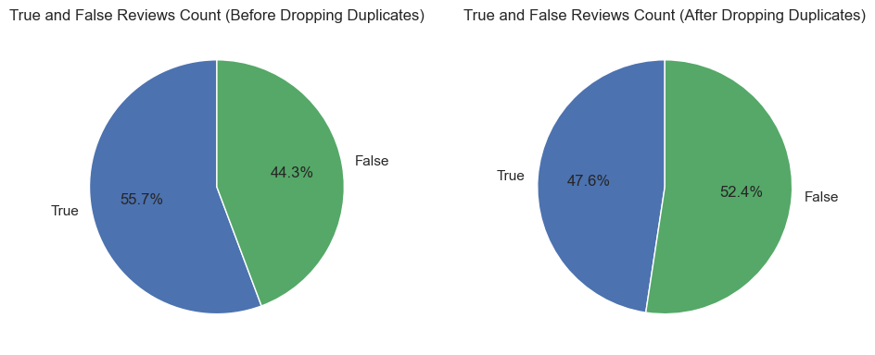
Analyzed reviews based on Verified Purchases (VP) data
Initial Review Distribution:
56% True reviews (from verified purchases)
44% False reviews (from non-verified purchases)
Majority of reviews come from actual purchasers, but a notable percentage are from non-purchasers.
Impact of Amazon's Verified Purchase System:
Helps reduce fake reviews by allowing only genuine purchasers to leave feedback.
Increases trust in the review system
Post-Duplicate Review Analysis:
After removing duplicates, True reviews dropped to 47%
False reviews increased to 52%, indicating a slight shift.
Dataset remains relatively balanced between true and false review
Notes:
We analyzed the Verified Purchases (VP) data, which tells us whether a review is from a customer who actually bought the product. Initially, the reviews were split between 56% true (from verified purchases) and 44% false (from non-verified purchases). This means that most reviews were from people who had purchased the product, but there was still a significant amount from those who hadn’t.
Amazon's Verified Purchase system helps reduce fake reviews by only allowing reviews from people who have made a purchase, giving more trust to the feedback.
After removing duplicate reviews, we found that True reviews dropped to 47% and False reviews increased slightly to 52%. This shows a small shift in the balance but overall, the dataset remains well-balanced between true and false reviews."

Slide 14
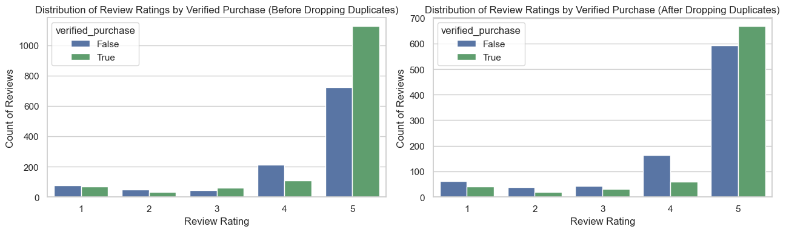
Analyzed reviews Ratings by Verified Purchases (VP) data
Impact of Removing Duplicates:
Significant drop in total review counts.
Distribution Consistency:
Proportion of true (verified purchases) and false reviews remains nearly unchanged.
5-Star Rating Dominance:
Majority of reviews still exhibit high ratings, indicating that duplicates do not inflate ratings.
Integrity of Ratings:
The overall integrity of the ratings distribution is preserved.
Fraudulent activity, if present, is evenly distributed across all ratings.
Notes:
After removing duplicate reviews, we found a significant decrease in total reviews, but the ratio of true to false reviews remained stable. The majority still have 5-star ratings, indicating that these ratings are not artificially inflated by duplicates. This confirms the integrity of the ratings distribution, with any fraudulent activity spread evenly across all ratings

Slide 15
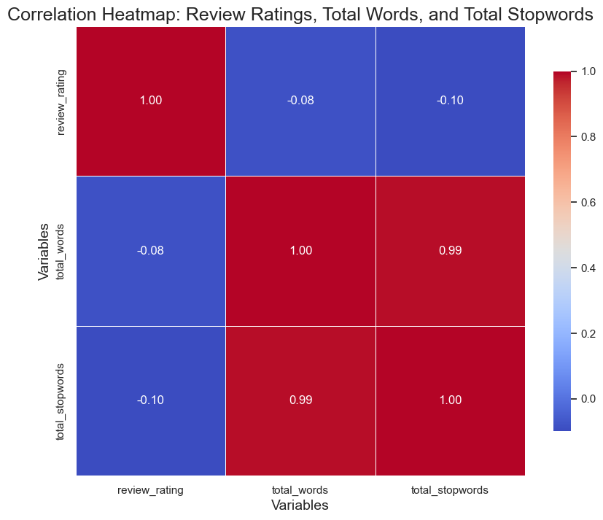
Correlation for Review Analysis
Variables Overview:
Review Ratings: Indicator of customer satisfaction.
Total Words: Total number of words in each review.
Total Stop words: Count of common, less significant words.
Heatmap Purpose:
Displays the strength and direction of relationships between variables.
Key Findings:
Strong Correlation (0.99)
Total Words ↔ Total Stop words
“Longer reviews tend to include more common words”
Weak Correlation (-0.08):
Review Ratings ↔ Total Words
"Review length has little effect on the ratings.“
Implications
Understanding these relationships helps in analyzing customer feedback effectively.
Notes:
"Now, let’s look at the relationship between review ratings, total words, and total stopwords.".
"There is a very strong correlation (0.99) between total words and total stopwords. This means that as the total number of words increases, so does the number of stopwords, which makes sense since longer reviews will naturally contain more common words like 'the' or 'and.’”
Interestingly, there’s a weak negative correlation (-0.08) between review ratings and the total number of words. This indicates that the length of the review has very little impact on its rating. Whether a review is long or short, the rating given by the customer remains largely unaffected
These insights suggest that while longer reviews tend to have more common words, the length of the review does not necessarily reflect the sentiment or satisfaction level of the reviewer

Slide 16
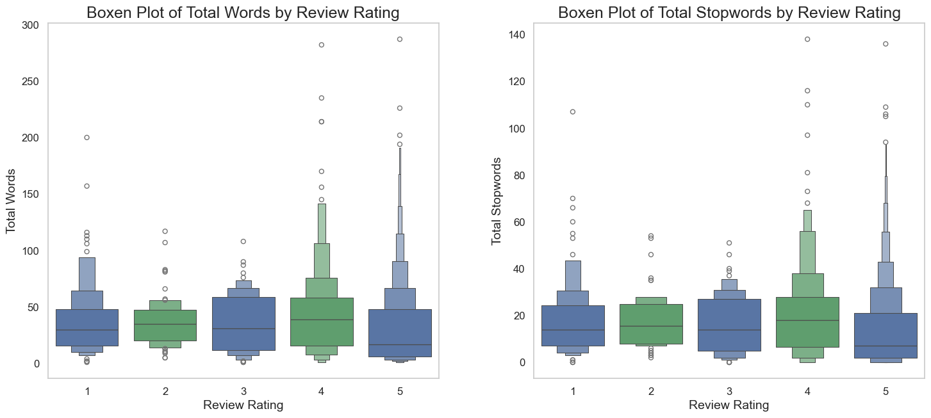
Analyzed Review Rating vs. Total Words & Stop words
Higher Ratings = Longer Reviews
Reviews with ratings of 4 and 5 tend to be longer, with a higher total word count.
This indicates that satisfied customers often provide more detailed feedback.
Lower Ratings = Shorter Reviews
Reviews with ratings of 1 and 2 tend to be shorter, both in terms of total words and stop words.
Stop words Correlate with Review Length
Higher-rated reviews also have more stop words, which aligns with longer review length.
Lower-rated reviews are concise, with fewer stop words and fewer outliers.
Notes:
"As we can see, reviews with higher ratings (4 and 5) tend to have a larger total word count, indicating that positive reviews are generally longer.“
"On the other hand, lower-rated reviews (1 and 2) are shorter, with fewer total words.“
"Similarly, the number of stopwords increases with the length of the reviews. This is expected because longer reviews naturally contain more common words.“
In conclusion, satisfied customers tend to write more detailed reviews, as seen from the longer word counts and higher stopword usage in higher-rated reviews.

Slide 17
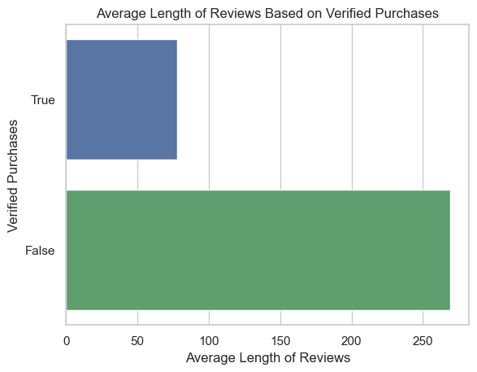
Analyzed Length of Reviews on Verified Purchases (VP)
False Reviews:
Average Length: >250 characters
Verified Reviews:
Average Length: 50-100 characters
Insight:
Longer reviews may indicate inauthenticity.
Conclusion:
Length can signal review authenticity.
Notes:
Introduce the Data on Review Lengths:
"We analyzed the average length of both false reviews and verified reviews. The results show a noticeable difference."
"False reviews tend to have an average length of over 250 characters, whereas verified reviews typically fall within 50-100 characters.“
Insight on Review Length:
"This suggests that longer reviews may indicate inauthenticity. Fraudulent reviews often try to overcompensate by providing excessive detail, which can stand out compared to genuine reviews.“
========================================================================================================
Conclusion on Review Authenticity:
"Therefore, review length can be a useful signal for detecting authenticity. Shorter reviews are more likely to be genuine, while unusually long reviews may raise red flags for potential fraud."

Slide 18
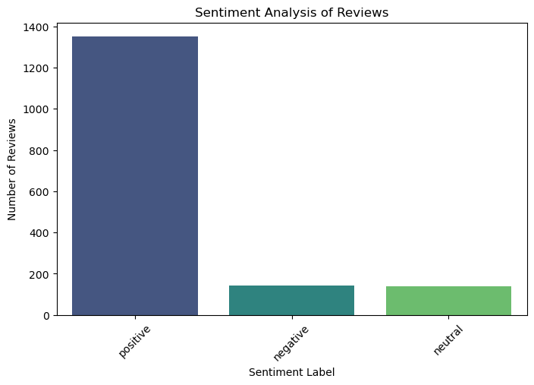
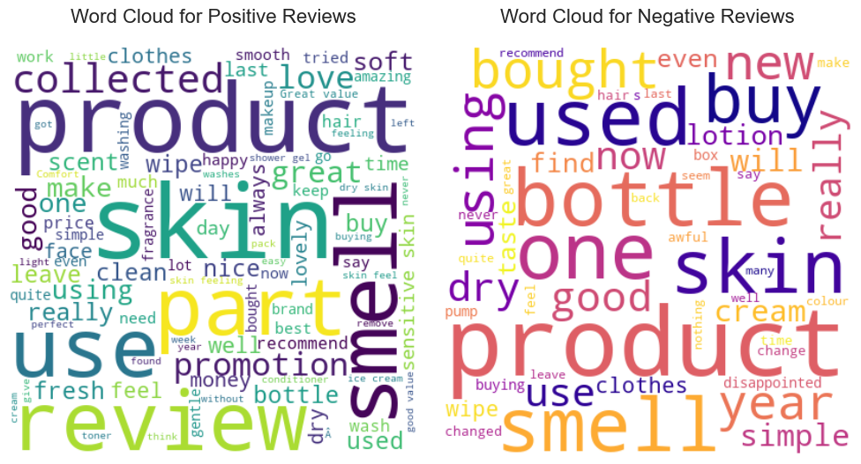
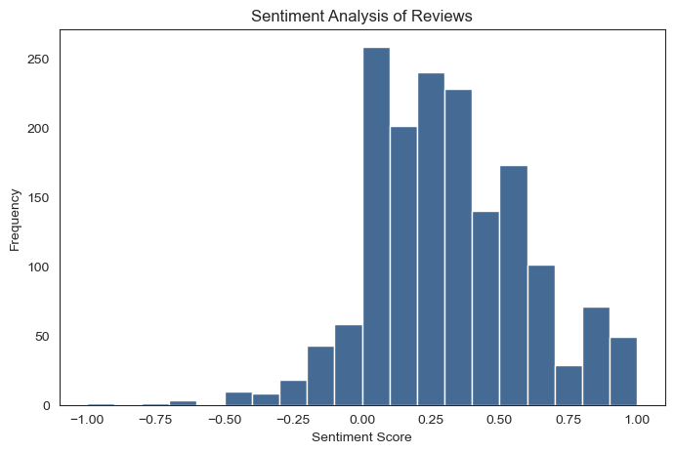
Sentiment Analysis of Reviews
The number of reviews categorized by sentiment—positive, negative, and neutral
Positive Reviews Word Cloud:
Highlight the big words like “smell,” “skin,” “part,” and “soft.” These are the words people use most when they say good things
Negative Reviews Word Cloud:
Show words like “bottle,” “one,” “buy,” and “disappointed.” These are the frequent words when people are unhappy.
X-Axis (Sentiment Score):
Ranges from -1.0 to 1.0 in increments of 0.25.
Scores close to -1 are highly negative, 0 is neutral, and scores close to 1 are highly positive.
Y-Axis (Frequency):
Shows how many reviews fall within each sentiment score range, ranging from 0 to 250.
Notes:
We analyzed the sentiment of the reviews to see how customers feel about the products—whether they are positive, negative, or neutral.
In the positive reviews, we found words like "smell," "skin," "part," and "soft" that show what customers appreciate most about the products.
On the other hand, negative reviews often mention words like "bottle," "one," "buy," and "disappointed," which highlight common issues customers face.
The X-axis of our graph shows sentiment scores from -1.0 to 1.0. Scores near -1 indicate strong negativity, 0 is neutral, and scores close to 1 indicate strong positivity.
The Y-axis shows how many reviews fit into each sentiment score range, going from 0 to 250. This helps us see the overall feelings of customers toward the products

Slide 19

Machine Learning Models
Notes:
Now, let's move on to the Modeling phase.
1. Introduction to the Models and Vectorizers
In this analysis, several machine learning models like Random Forest, Gradient Boosting, and Support Vector Machines (SVM) were used. These models were trained on text data that was transformed into numerical data using different vectorization techniques like TF-IDF, Count Vectorizer, and N-gram. These techniques help convert the text into numbers so the models can classify the data
2. Metrics Breakdown
We evaluated each model using different performance metrics. Accuracy tells us how often the model makes correct predictions. Precision tells us how many of the predicted positives were actually correct. Recall shows how many of the actual positives were correctly identified, and F1 Score balances both precision and recall.“
3. Interpreting Accuracy
Looking at the table, we can see that Support Vector Machine (SVM) has the highest accuracy of 81.69% using the Character Level Vectorizer. This means it correctly predicted the label in about 82% of the cases. Logistic Regression (LR) and Random Forest Classifier (RFC) also performed well across different vectorizers, especially the Count Vectorizer and Hashing Vectorizer.“
4. Precision and Recall Trade-off
SVM has a high precision score of 80.33% with the Hashing Vectorizer, meaning when it predicted a positive class, it was correct 80% of the time. However, its recall is slightly higher with the N-gram Vectorizer at 95.09%, meaning it was very good at identifying actual positives. There's often a trade-off between precision and recall. For instance, Naive Bayes (MNB) achieved very high precision with TF-IDF but lower recall, indicating it's more conservative in predicting positives
5. F1 Score: The Balance
F1 Score combines both precision and recall into a single metric, which is important when we need a balance between these two. For example, Random Forest (RFC) performs well in terms of F1 Score across different vectorizers, especially with 85.96% using TF-IDF. This shows that it's not only good at identifying positives but also maintaining a good balance between precision and recall.“
6. Impact of Vectorizers
The choice of vectorizer also impacts model performance. For instance, GBC performs similarly across all vectorizers, but models like SVM show significant improvements with the TF-IDF vectorizer, especially in terms of accuracy and recall. This indicates that some models respond better to certain representations of the text data.“
7. Conclusion and Recommendation
In conclusion, while all models have their strengths, Support Vector Machine (SVM) and Random Forest (RFC) consistently performed well across different vectorizers, especially with TF-IDF and N-gram. For future projects, using a combination of these models and vectorizers could yield better results depending on the specific goals of the analysis."

Slide 20
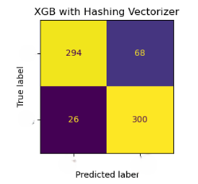
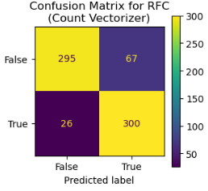
Comparing Machine Learning Models
 | Accuracy (%) |  |  |  |  | Precision (%) |  |  |  |  | Recall (%) |  |  |  |  | F1 Score (%)
Model | Character Level Vectorizer | Count Vectorizer | Hashing Vectorizer | N-gram Vectorizer | TF-IDF Vectorizer | Character Level Vectorizer | Count Vectorizer | Hashing Vectorizer | N-gram Vectorizer | TF-IDF Vectorizer | Character Level Vectorizer | Count Vectorizer | Hashing Vectorizer | N-gram Vectorizer | TF-IDF Vectorizer | Character Level Vectorizer | Count Vectorizer | Hashing Vectorizer | N-gram Vectorizer | TF-IDF Vectorizer
GBC | 79.94 | 84.45 | 83.87 | 83.43 | 83.43 | 79.56 | 78.15 | 78.07 | 76.63 | 77.75 | 77.61 | 93.25 | 91.72 | 93.56 | 91.10 | 78.57 | 85.03 | 84.34 | 84.25 | 83.90
LR | 79.22 | 80.67 | 79.36 | 78.49 | 79.51 | 73.28 | 78.47 | 78.93 | 70.51 | 79.94 | 88.34 | 81.60 | 76.99 | 93.87 | 75.77 | 80.11 | 80.00 | 77.95 | 80.53 | 77.80
MNB | 56.54 | 79.80 | 72.09 | 76.74 | 80.38 | 55.34 | 82.81 | 87.64 | 79.23 | 82.59 | 42.94 | 72.39 | 47.85 | 69.02 | 74.23 | 48.36 | 77.25 | 61.90 | 73.77 | 78.19
RFC | 79.94 | 86.48 | 86.19 | 83.58 | 86.19 | 79.94 | 81.74 | 81.30 | 76.43 | 81.47 | 76.99 | 92.02 | 92.02 | 94.48 | 91.72 | 78.44 | 86.58 | 86.33 | 84.50 | 86.29
SVM | 81.98 | 82.27 | 79.22 | 69.48 | 80.38 | 79.53 | 78.02 | 81.02 | 61.07 | 83.99 | 83.44 | 87.12 | 73.31 | 98.16 | 72.39 | 81.44 | 82.32 | 76.97 | 75.29 | 77.76
XGB | 78.20 | 84.01 | 84.45 | 85.76 | 85.03 | 76.51 | 80.51 | 82.30 | 81.84 | 81.59 | 77.91 | 87.42 | 85.58 | 89.88 | 88.34 | 77.20 | 83.82 | 83.91 | 85.67 | 84.83
Notes:
Here I tested multiple models to accurately detect fraudulent reviews, improving customer trust in the feedback system
To identify fraudulent reviews with high accuracy while minimizing false positives.
I explored various machine learning models, such as Random Forest, Support Vector Machine, and XGBoost, using different methods to vectorize the text data (e.g., Count Vectorizer, TF-IDF, N-gram).
Random Forest Classifier (RFC) with Count Vectorizer is the top-performing model with an accuracy of 86.48% and recall of 92.02%, making it the best option for detecting fraud while maintaining a low number of missed fraudulent reviews.
Accuracy: 86.48%Precision: 81.74%
Recall: 92.02%F1 Score: 86.58%
True Negatives (TN): 295 — Reviews correctly predicted as not fraudulent.
False Positives (FP): 67 — Reviews incorrectly flagged as fraudulent.
False Negatives (FN): 26 — Fraudulent reviews missed by the model.
True Positives (TP): 300 — Fraudulent reviews correctly identified.
Multinomial Naive Bayes (MNB) with Hashing Vectorizer is highly precise but less effective in detecting all fraudulent reviews, with a recall of 47.85%.
Accuracy: 72.09%Precision: 87.64%
Recall: 47.85%F1 Score: 61.90%
True Negatives (TN): 340
False Positives (FP): 22
False Negatives (FN): 170
True Positives (TP): 156
Support Vector Machine (SVM) with N-gram Vectorizer detects almost all fraudulent reviews with a recall of 98.16%, but the high number of false positives (204) could result in unnecessary manual reviews.
Accuracy: 69.48%
Precision: 61.07%
Recall: 98.16%
F1 Score: 75.29%
True Negatives (TN): 158
False Positives (FP): 204
False Negatives (FN): 6
True Positives (TP): 320

Slide 21
Comparing Machine Learning Models
 | Model | Vectorizer | Accuracy (%) | Precision (%) | Recall (%) | F1 Score (%) | TN | FP | FN | TP
15 | RFC | Hashing Vectorizer | 0.86 | 0.82 | 0.91 | 0.86 | 295 | 67 | 29 | 297
23 | XGB | N-gram Vectorizer | 0.86 | 0.82 | 0.90 | 0.86 | 297 | 65 | 33 | 293
3 | RFC | Count Vectorizer | 0.86 | 0.81 | 0.91 | 0.86 | 291 | 71 | 28 | 298
11 | XGB | TF-IDF Vectorizer | 0.85 | 0.82 | 0.88 | 0.85 | 297 | 65 | 38 | 288
9 | RFC | TF-IDF Vectorizer | 0.85 | 0.80 | 0.91 | 0.85 | 286 | 76 | 28 | 298
 | Model | Vectorizer | Accuracy (%) | Precision (%) | Recall (%) | F1 Score (%) | TN | FP | FN | TP
47 | XGB | Hashing Vectorizer | 0.86 | 0.87 | 0.86 | 0.86 | 294 | 68 | 26 | 300
17 | XGB | Hashing Vectorizer | 0.86 | 0.87 | 0.86 | 0.86 | 294 | 68 | 26 | 300
9 | RFC | TF-IDF Vectorizer | 0.86 | 0.86 | 0.86 | 0.86 | 289 | 73 | 26 | 300
45 | RFC | Hashing Vectorizer | 0.85 | 0.86 | 0.85 | 0.85 | 288 | 74 | 26 | 300
39 | RFC | TF-IDF Vectorizer | 0.85 | 0.86 | 0.85 | 0.85 | 287 | 75 | 26 | 300
Notes:
Here I tested multiple models to accurately detect fraudulent reviews, improving customer trust in the feedback system
To identify fraudulent reviews with high accuracy while minimizing false positives.
I explored various machine learning models, such as Random Forest, Support Vector Machine, and XGBoost, using different methods to vectorize the text data (e.g., Count Vectorizer, TF-IDF, N-gram).
Random Forest Classifier (RFC) with Count Vectorizer is the top-performing model with an accuracy of 86.48% and recall of 92.02%, making it the best option for detecting fraud while maintaining a low number of missed fraudulent reviews.
Accuracy: 86.48%Precision: 81.74%
Recall: 92.02%F1 Score: 86.58%
True Negatives (TN): 295 — Reviews correctly predicted as not fraudulent.
False Positives (FP): 67 — Reviews incorrectly flagged as fraudulent.
False Negatives (FN): 26 — Fraudulent reviews missed by the model.
True Positives (TP): 300 — Fraudulent reviews correctly identified.
Multinomial Naive Bayes (MNB) with Hashing Vectorizer is highly precise but less effective in detecting all fraudulent reviews, with a recall of 47.85%.
Accuracy: 72.09%Precision: 87.64%
Recall: 47.85%F1 Score: 61.90%
True Negatives (TN): 340
False Positives (FP): 22
False Negatives (FN): 170
True Positives (TP): 156
Support Vector Machine (SVM) with N-gram Vectorizer detects almost all fraudulent reviews with a recall of 98.16%, but the high number of false positives (204) could result in unnecessary manual reviews.
Accuracy: 69.48%
Precision: 61.07%
Recall: 98.16%
F1 Score: 75.29%
True Negatives (TN): 158
False Positives (FP): 204
False Negatives (FN): 6
True Positives (TP): 320

Slide 22
Comparing Machine Learning Models
Classification Model
Text Vectorizers
Count Vectorizer
TF-IDF Vectorizer
Hashing Vectorizer
N-gram Vectorizer
Character Level Vectorizer
MULTINOMIAL NAIVE BAYES,
Support Vector Machine,
LOGISTIC REGRESSION,
RANDOM FOREST,
GRADIENT BOOSTING,
XGBOOST
Notes:
Here I tested multiple models to accurately detect fraudulent reviews, thereby enhancing customer trust in the feedback system. The goal was to identify fraudulent reviews with high accuracy while minimizing false positives
I explored various machine learning models, such as MULTINOMIAL NAIVE BAYES,
Support Vector Machine,
LOGISTIC REGRESSION,
RANDOM FOREST,
GRADIENT BOOSTING,
XGBOOST
, using different methods to vectorize the text data (e.g., Count Vectorizer, TF-IDF, N-gram).
=============================================================================================================
Methodology
Machine Learning Models: We explored several machine learning algorithms that are well-suited for classification tasks:
Random Forest: An ensemble method that combines multiple decision trees to improve accuracy and reduce overfitting.
Support Vector Machine (SVM): A powerful model that finds the optimal hyperplane to separate classes in high-dimensional spaces.
XGBoost: An advanced boosting algorithm known for its performance and efficiency, especially in handling large datasets.
Text Vectorization Methods: To effectively analyze the text data from reviews, we employed different vectorization techniques:
Count Vectorizer: Converts text documents into a matrix of token counts, allowing us to see the frequency of each word.
TF-IDF (Term Frequency-Inverse Document Frequency): This method weights the importance of words based on their frequency across all documents, helping to highlight more informative words.
N-gram Vectorization: Captures sequences of words (bigrams, trigrams) to understand context better, which is crucial for detecting fraudulent patterns.
Results
Performance Metrics: Each model's performance was evaluated based on key metrics:
Accuracy: The overall correctness of the model.
Precision: The proportion of true positive results in the predictions, important to minimize false positives.
Recall: The ability of the model to identify all relevant cases of fraud.
F1 Score: A balance between precision and recall, giving us a single metric to assess the model’s performance.
Comparison: After evaluating various combinations of models and vectorizers, we identified the best-performing model that not only achieved high accuracy but also minimized the risk of misclassifying legitimate reviews as fraudulent.
Conclusion
Customer Trust: By implementing these models and techniques, we aim to significantly improve the accuracy of our fraud detection system. This will enhance the credibility of customer feedback and ultimately build stronger trust in our platform.
Next Steps: We recommend ongoing monitoring and fine-tuning of the model, along with a periodic review of the text vectorization methods, to adapt to new trends in fraudulent behavior.

Slide 23
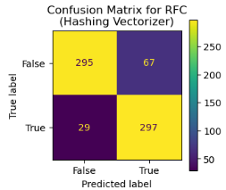
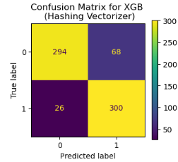
Best Machine Learning Models
Metric | Value
Model | Random Forest Classifier (RFC)(without hyperparameters)
Vectorizer | Hashing Vectorizer
Accuracy (%) | 0.86
Precision (%) | 0.82
Recall (%) | 0.91
F1 Score (%) | 0.86
True Negatives (TN) | 295
False Positives (FP) | 67
False Negatives (FN) | 29
True Positives (TP) | 297
Metric | Value
Model | XGBoost (XGB)(with hyperparameters)
Vectorizer | Hashing Vectorizer
Accuracy (%) | 0.86
Precision (%) | 0.87
Recall (%) | 0.86
F1 Score (%) | 0.86
True Negatives (TN) | 294
False Positives (FP) | 68
False Negatives (FN) | 26
True Positives (TP) | 300
Best Parameters | {'classifier__n_estimators': 100, 'classifier__max_depth': 5, 'classifier__learning_rate': 0.1}
Notes:
Random Forest Classifier
Accuracy: 86% – This model effectively identifies fraudulent reviews without needing extra adjustments.
Recall Rate: 91% – It does an excellent job of detecting genuine fraudulent reviews.
Precision Rate: 80% – This helps minimize false positives, ensuring that most flagged reviews are indeed fraudulent.
F1 Score: 86% – This score shows the model’s reliability in classifying reviews.
XGBoost Model
Accuracy: 86% (after optimization) – This model also effectively distinguishes between fraudulent and genuine reviews.
Precision: Higher than Random Forest – This means it is better at minimizing false positives.
Recall: Comparable to Random Forest – It effectively identifies fraudulent reviews.
Choosing the Right Model
If you want to reduce false positives, XGBoost is the better option due to its higher precision.
If detecting as many fraud cases as possible is your priority, Random Forest is superior because of its higher recall.
For a balanced approach, XGBoost with optimization is preferred due to its strong overall performance.

Slide 24
Outcomes and Implementation
Outcomes
Best Model:
XGBoost: 0.86% accuracy(with hyperparameters)
Model Performances:
Precision: 0.87%
Feature Importance:
Word frequency, sentiment scores, review length
Validation:
Cross-validation ensures robustness
Deployment Ready:
Integrable with existing systems
Recall: 0.86%
F1Score: 0.86%
56% True reviews (from verified purchases)
44% False reviews (from non-verified purchases)
Longer reviews may indicate inauthenticity.
Implementation
User-Friendly Dashboard:
Visualizes detection results in real-time
Intuitive interface for easy navigation
Features real-time alerts for suspicious review activities..
API Integration:
Seamless integration with existing review management systems.
Facilitates automated fraud detection and reporting.
Supports multiple data formats for flexibility.
Training and Support:
Comprehensive training sessions for staff.
User manuals and documentation provided.
Ongoing technical support available
Regular updates to enhance functionality
Notes:
Best Model: XGBoost
Accuracy: 86% (after tuning) – This means our model is very reliable in detecting fraudulent reviews.
Model Performance Metrics:
Precision: 87% – This indicates that when the model flags a review as fraudulent, it’s likely correct.
Recall: 86% – The model effectively identifies most genuine fraudulent reviews.
F1 Score: 86% – This score shows a good balance between precision and recall.
Feature Importance:
Key factors that help in detection include:
Word Frequency: Common words used in reviews.
Sentiment Scores: Overall feeling conveyed in the review.
Review Length: Longer reviews may suggest inauthenticity.
Review Distribution:
56% of reviews are true (from verified purchases).
44% are false (from non-verified purchases).
Validation:
We used cross-validation to confirm that our model is robust and reliable.
Deployment Ready:
The model can be easily integrated with your existing systems, ensuring a smooth transition.
Implementation Plan Overview
User-Friendly Dashboard:
We will create a dashboard that visualizes fraud detection results in real time, making it easy for users to navigate and receive alerts for any suspicious review activities.
API Integration:
Our solution will seamlessly integrate with your existing review management systems, enabling automated fraud detection and reporting while supporting various data formats for flexibility.
Training and Support:
We’ll provide comprehensive training sessions for your staff, along with user manuals and ongoing technical support. Regular updates will also be provided to enhance functionality over time.

Slide 25
THANK YOU
Notes:
“Thank you for your time and attention

